Slide 1
PM Review - G7T8
~888~
Project Manager: Xu Ying
Group Members: Andy, Daniel, Hani, Hong Yuan

Slide 2
Agenda
Functionalities
Schedule
Metrics
Roles & Responsibilities
Pair Programming

Slide 3
Functionalities

Slide 4


Functionalities
Drop any functionalities?
Add any functionalities?

Slide 5
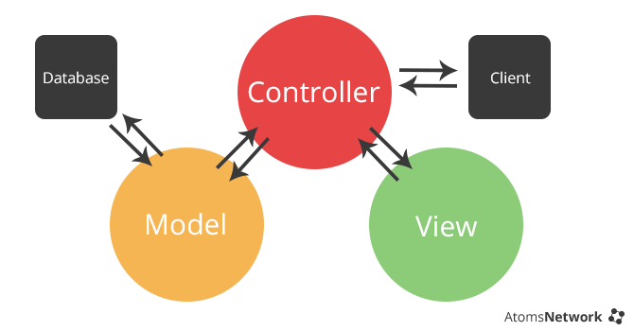
No Framework
To determine the flow of the program and have the logic to handle a request e.g. UserServlet.java
For data management e.g. UserDAO.java
To build the end-user presentation layer
Notes:
MVC architecture vs MVC framework
Architecture is how you designed your application. If the design of your JEE application is MVC architecture (aka JSP Access Model 2), your application has servlets as Controller, JSPs as views and Java class as model.
MVC framework is a set of libraries that makes it easy to design your application in MVC architecture. Your application will implement interfaces and/or extend classes from the framework's libraries, and setup configuration files. Example of MVC frameworks are Struts, Spring, Stripes and others.
MVC
MVC stands for "Model-View-Controller"
Model
Entities represented real world objects – people, places, things, transactions. E.g. student, school, course, bidding.
Data Access Objects (DAO) persists entities to storage (save/load from database, files, etc.). It decouples the persistence code from the rest of the system.
View talks to the user; i.e. UI. View passes user’s inputs to controller. It also displays the results from controller.
Controller coordinates objects in the model to achieve a function.
Example:
Student (user) enters course bidding details in the bidding form view.
The view passes these bidding details to a controller.
The controller coordinates objects in the model
Creates a Bidding object. The Bidding object will raise error if there is not enough e$, etc.
If no error, controller calls BiddingDAO to save the Bidding & passes Bidding object to a success view to display.
If error, controller passes back the error details (can be a code, exception, etc.) to bidding form view to display.
Simplistic speaking, MVC is a guideline on how you should organise your code to achieve low coupling, high cohesion, and all the good things. Aka it’s a design pattern – wisdom from our IT predecessors.
JSP Model 1 and Model 2
Simplistic speaking, JSP Model 1 has only JSPs. JSP speaks with the model directly to get information. https://en.wikipedia.org/wiki/JSP_model_1_architecture
JSP model 1 does not recommend anything related to MVC.
However, I can enforce my own procedures to achieve “MVC”. E.g. I can define all JSP named "process*.jsp" acts like controllers.
In SE context, JSP Model 2 is MVC. It recommends how to organise your code to achieve MVC. https://en.wikipedia.org/wiki/JSP_model_2_architecture
Servlets are used for controllers, JSP for views, normal Java classes (aka Java beans) for model.
The controller may pass 1 or more entities to the view. The view displays the information represented by the entities.

Slide 6
Schedule

Slide 7

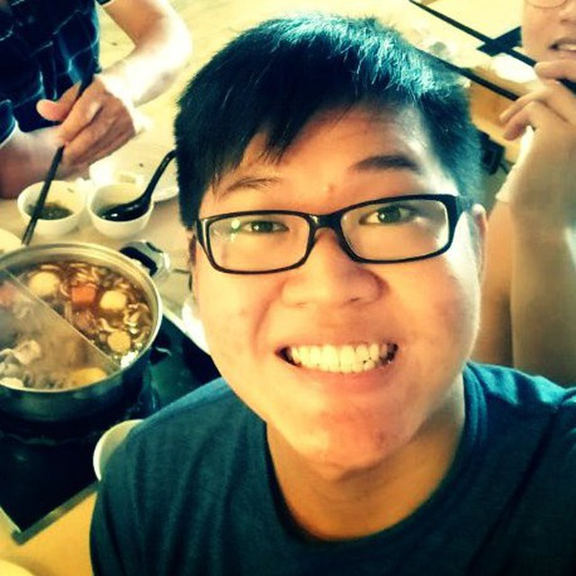




Schedule
Heatmap GUI & function
Bootstrap GUI & function
Automatic group identification GUI
Top nextk & top companion report function
Login Page GUI
User Page GUI
Admin Page GUI
Iteration 1
Iteration 3
Iteration 2
3 4 5 6 7 8 9
Login function
Location report GUI
Breakdown&
top k report function
Notes:
We will work on Bootstrap GUI & function, Top companion & top k next report function and AGI GUI on week 8 (recess week)

Slide 8

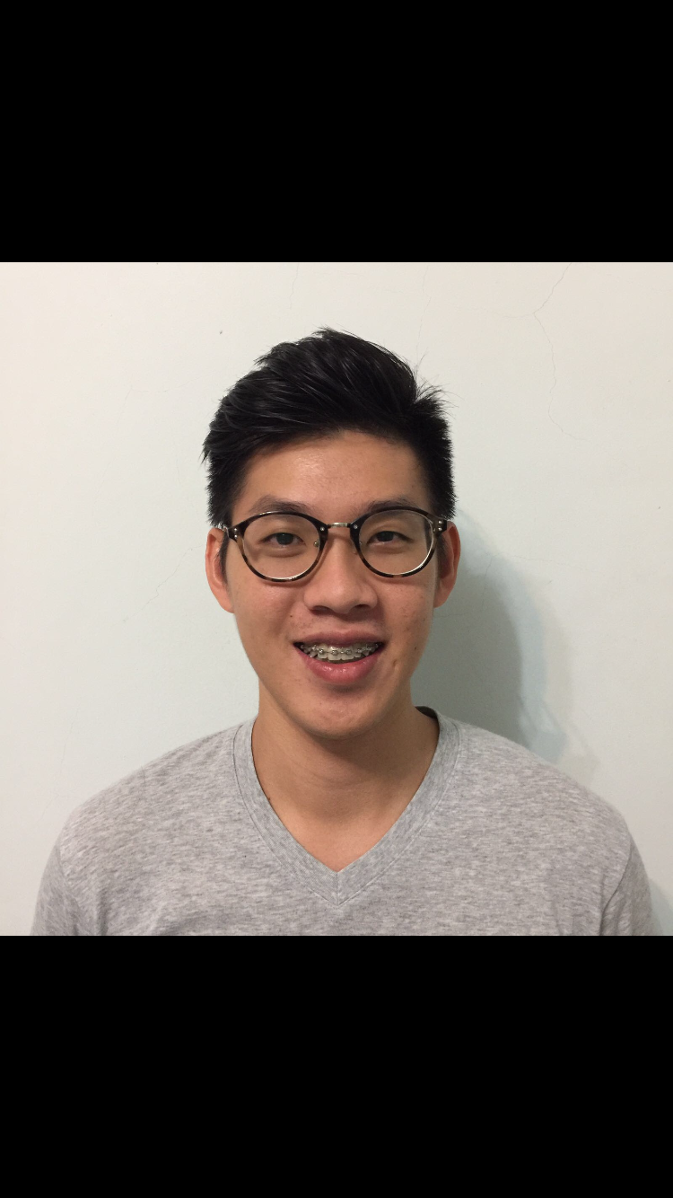
Schedule
JSON & web service
Automatic group identification function
Improve UI & debug functions
Finalize the project
Iteration 4
Iteration 6
Iteration 5
9 10 11 12 13 14 15
Improve UI & debug functions
Notes:
We will work on Bootstrap GUI & function, Top companion & top k next report function and AGI GUI on week 8 (recess week)

Slide 9
Iteration Process
Project Planning & Analysis
Understanding project requirements
Plan out the schedule
Analysis & Design
Understanding the function requirement
Design the UI
Coding & Implementation
Code the GUI and functions
Integration
Integrate the related functions
Testing & evaluation
Test function and GUI
Notes:
We fully focus on our pair programming - every ½ hr we switch
We foresee future iterations where we will spend more time

Slide 10

Iteration 1&2
Login Page GUI
User Page GUI
Admin Page GUI
Iteration 1
Iteration 2
3 4 5 6 7
Login function
Location report GUI
Breakdown & top k report function

Slide 11

Iteration 3&4
Automatic group identification GUI
Heatmap GUI & function
Bootstrap GUI & function
Top companion & top next k report function
Iteration 3
Iteration 4
7 8 9 10 11
JSON & web service
Automatic group identification function
Improve GUI & Function
Notes:
Plan to finish Bootstrap GUI & function, Top companion & top next k report function and AGI GUI by end of week 8
Login required to be printed in JSON format
Why do we need to print in JSON format?
Widely-supported

Slide 12
Iteration 5&6
Improve UI & debug functions
Iteration 5
Iteration 6
11 12 13 14 15
Finalize the project
Notes:
Iteration 5
Improving the UI if need be (for better experience)
Debug codes if we find bugs from our code

Slide 13
Iteration | Functionalities | Tasks | Andy | Daniel | Hani | Hong Yuan | Xu Ying
#1 | Login | Login Page |  |  | ✔ |  | ✔
 |  | User Page |  |  | ✔ |  | ✔
 |  | Admin Page |  | ✔ |  | ✔
#2 | Basic Location Report Heatmap | Breakdown | ✔ |  | ✔
 |  | TopK Popular Places |  |  |  | ✔ | ✔
#3 | Heatmap |  | ✔ |  | ✔
 | Bootstrap | Upload |  | ✔ |  | ✔
 |  | Delete | ✔ |  | ✔
 | Basic Location Report | TopK companion |  | ✔ |  | ✔
 |  | TopK next place | ✔ |  | ✔
#4 | JSON & Web services |  | ✔ |  |  | ✔
 | Automatic group identification |  |  | ✔ |  |  | ✔

Slide 14
Milestones
Iteration 3
Iteration 4
Iteration 5
Iteration 6
1
2
3
4
7 8 9 10 11 12 13 14 15
Week | 7 | 10 | 12 | 14
Milestone | PM Review | Application Demo & Process Update | UAT | Final Presentation
PM | Xu Ying | Hani | Hong Yuan | Andy
Tasks | Prepare schedule, metrics, PP rotation Prepare presentation slides | •Prepare two fully functional functions other than login •Update progress | •Improve from critics •Prepare a full-functional project with all functions | •Debug & test with all test cases from UAT •Prepare for final presentation

Slide 15
2 Days
Buffer Time
Before Every Milestone

Slide 16
Critical Path
Minimum time to complete the project

Slide 17
Iteration 1
Project analysis & planning
(1 day)
Diagrams designing (2 days)
Login Page, Home Page & Admin Page (GUI)
(2 days)
Notes:
Critical path: minimum time to complete the project ()
Longest path through the network
Everything is critical path, we will use two buffer days if we can’t finish
-2 buffer days

Slide 18
Iteration 2
Login functionality 1 day
Slack
3 days
Database (1 day)
Integration
(1 day)
Basic location report (GUI)
(1 day)
Breakdown & topK Report (3 day)
Notes:
Critical path: minimum time to complete the project ()
Longest path through the network
Everything is critical path, we will use two buffer days if we can’t finish

Slide 19
Iteration 3
Bootstrap UI (1 day)
Bootstrap function (4 days)
Automatic Group Identification GUI (1 day)
Diagrams designing
Test integrated code (3 days)
Heatmap UI (1 day)
Heatmap function
(2 days)
TopK companions Report
(1 day)
TopK next Report
(1 day)
Heatmap & Report integration
(1 day)
Slack 1 day
Notes:
Critical path: minimum time to complete the project ()
Longest path through the network
Everything is critical path, we will use two buffer days if we can’t finish

Slide 20
Iteration 4
Improve UI & functionality (2 days)
Debug & Test UI & functionality
(2 days)
Slack 2 day
Diagrams designing
(1 day)
Use test cases to debug and test
(2 days)
JSON & web service (3 days)
Automatic Group Identification function (3 days)
Notes:
Critical path: minimum time to complete the project ()
Longest path through the network
Everything is critical path, we will use two buffer days if we can’t finish

Slide 21
Iteration 5
UAT Preparation
Debug & Test UI & functionality (4 days)
UAT Test
Notes:
Critical path: minimum time to complete the project ()
Longest path through the network
Everything is critical path, we will use two buffer days if we can’t finish

Slide 22
Iteration 6
Final Presentation Preparation
Finalize the project (4 days)
Final Presentation
Notes:
Critical path: minimum time to complete the project ()
Longest path through the network
Everything is critical path, we will use two buffer days if we can’t finish

Slide 23
Metrics

Slide 24
Iterative time boxing

Slide 25
Task Metrics
Iteration No. | Planned Tasks | Completed Tasks | TM
1 | 7 | 7 | 1
2 | 19 | 19 | 1
Notes:
TM calculation

Slide 26
Task Metrics
Score(%) | Action
TM < 50 | Immediately, inform your supervisor about the slip within 24 hours. Then use the same mitigation as the category 50 < TM < 90 and seriously consider dropping tasks.
50 < TM <= 90 | Re-estimate the tasks for the future iterations. Deduct the number of days behind schedule from buffer days. If there is no more buffer day, decide the functionalities to drop.
90 < TM <= 110 | Our estimates are fairly accurate, and we are roughly on track. Add/Deduct the number of days behind schedule from buffer days. If there is no more buffer day, decide the functionalities to drop
110 < TM <= 150 | Gross over-estimated the effort required. Re-estimate the tasks for the future iterations. Add the number of days gained to buffer days.
150 < TM | Immediately, inform your supervisor about the slip within 24 hours. Then use the same mitigation as the category 110 < SM < 150

Slide 27
Bug Metrics
Current bug metrics score:
We have solved all the bugs found in testing, using our planned debugging time in the iteration

Slide 28
Bug Metrics: Mitigation Plan
Severity | Description
Low Impact (1 points) | Unimportant. Typo error or small user interface alignment issues.
High Impact (5 points) | The system runs. However, some non-critical functionalities are not working.
Critical Impact(10 points) | The system is down or is usable after a short period of time. We have to fix the bugs to continue.
Points in Iteration | Action
Points < 10 | Use the planned debugging time in the iteration.
Points >= 10 | Stop current development and resolve the bug immediately. Project Manager reschedules the project.

Slide 29
Roles & Responsibility

Slide 30
Responsibilities of Programmers
Always pull git first
Liaise with your partner to pair program
Always know what the other pair is doing
Remember to update actual time spent in schedule
Add comments in the codes for our understanding
Do not push to git outside of pair programming session

Slide 31
Responsibilities of PM
Update minutes & discussion topics for each week
Update and manage schedule & metrics
Update team members
Book GSR/SR for meetings
Assign tasks and update pair programming tasks
Help to code sometimes too

Slide 32
Pair Programming

Slide 33
Rotation Plan for Pair Programming
Iteration No. | Date | Project Manager | Pair Programmers 1 | Pair Programmers 2 | Milestones
1 | 4 Sept - 17 Sept | Andy | Hani & XY | Daniel & HY | Nil
2 | 18 Sept - 1 Oct | Daniel | Andy & Hani | HY & XY | Nil
3 | 2 Oct - 15 Oct | Xu Ying | Daniel & HY | Andy & Hani | PM Review
4 | 16 Oct - 29 Oct | Hani | Daniel & XY | Andy & HY | Prototype Demo
5 | 30 Oct - 12 Nov | Hong Yuan | Daniel & Hani | Andy, XY | UAT
6 | 13 Nov - 26 Nov | Andy | XY & Hani | Daniel & HY | Final Presentation
Notes:
Show current progress

Slide 34
Thank You

Slide 35
Q&A

